Slide 1
Microsoft Teams
Chat based workspace in Office 365 – Partner Extensibility Opportunities
<speaker>

Slide 2





Chat-based workspace in Office 365
Chat for today’s teams
A hub for teamwork
Customizable for each team
Security teams trust
Communicate in the moment and keep everyone in the know
Give your team quick access to information they need right in Office 365
Tailor your workspace to include content and capabilities your team needs everyday
Get the enterprise-level security and compliance features you expect from Office 365
Extensible platform
Build apps with a rich set of capabilities to enable these higher-performing teams

Slide 3
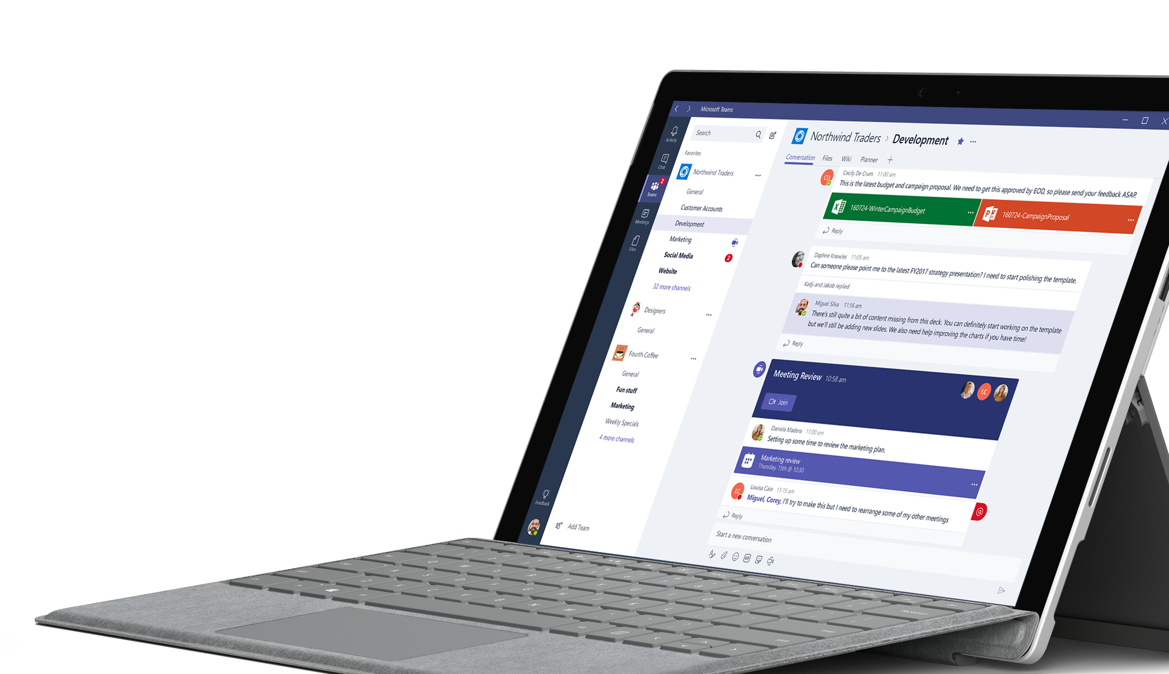
Tap into the global availability of Microsoft Teams
181
19
Markets
Languages

Slide 4
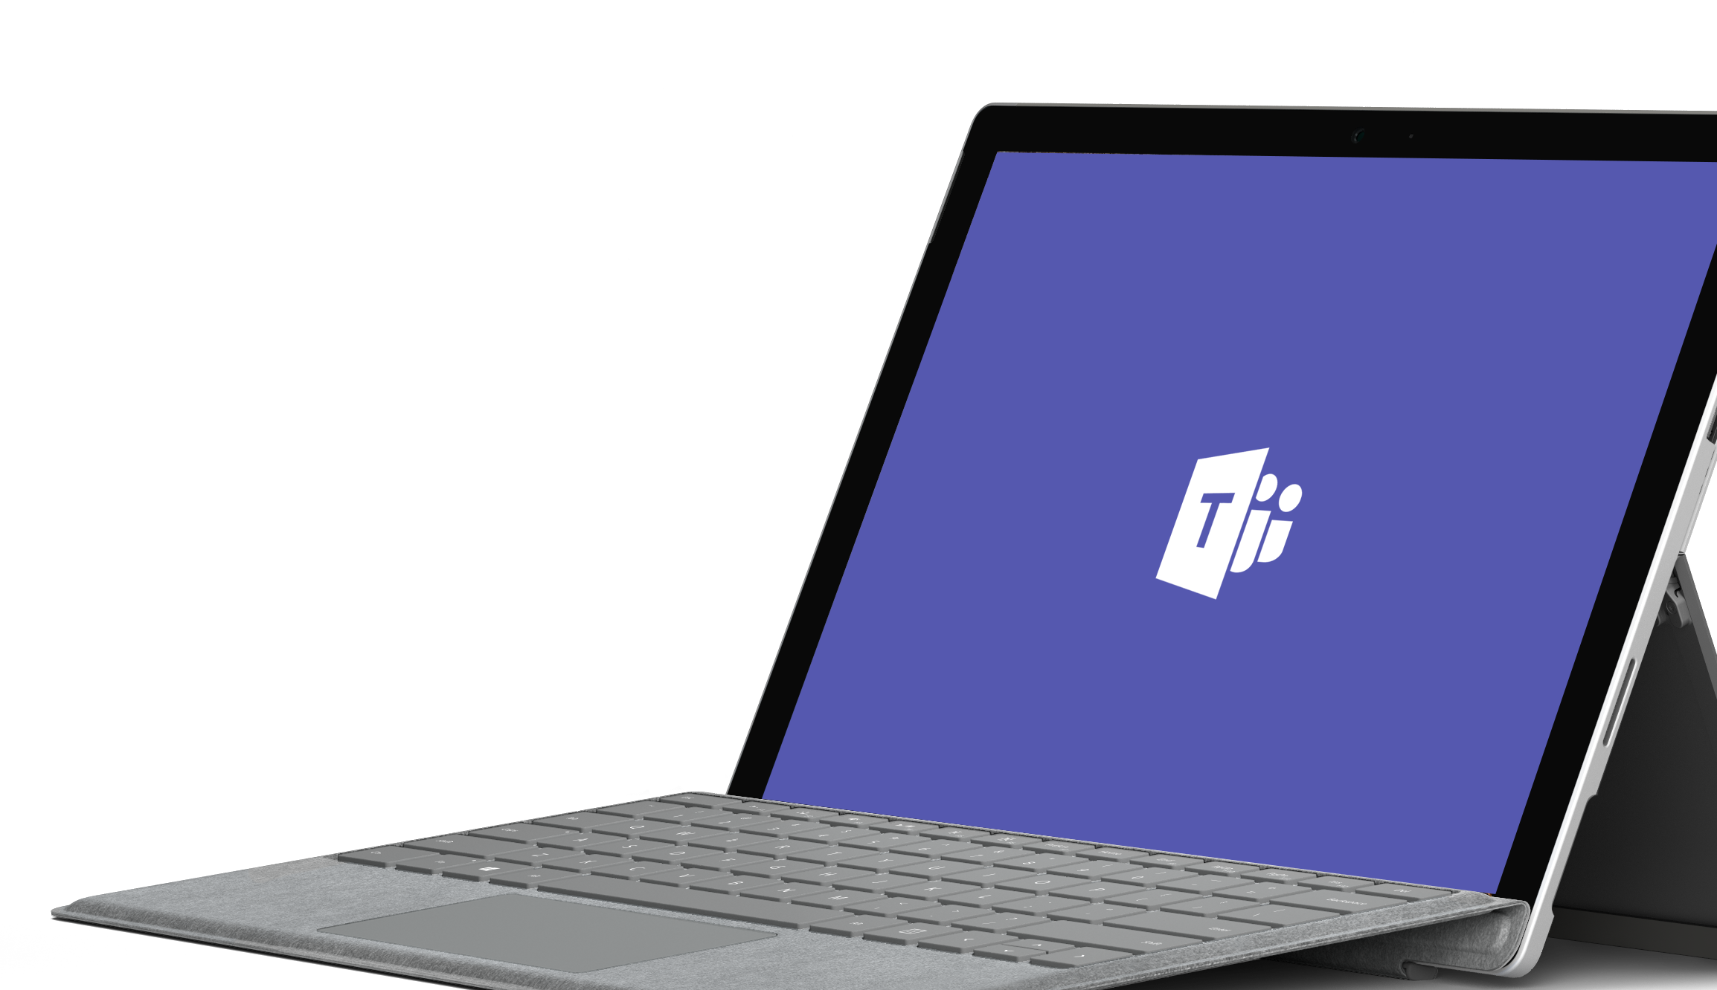
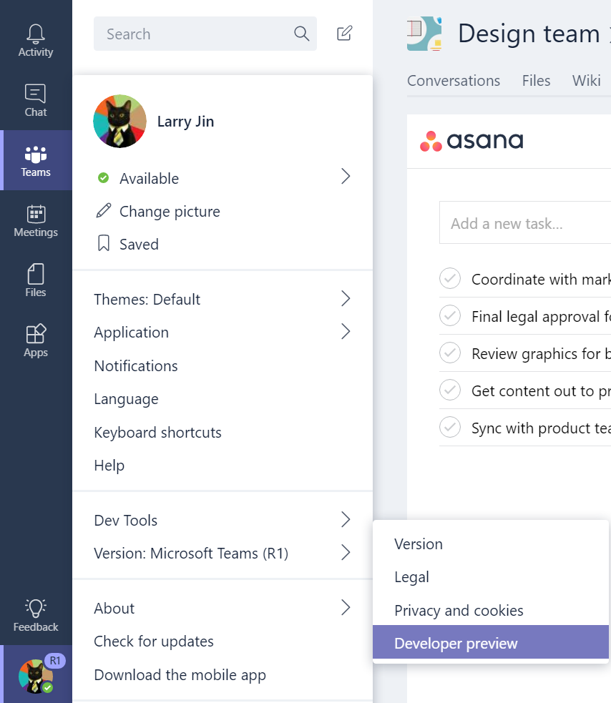
Demo
Enable Dev Preview features

Slide 5







Introducing the Microsoft Teams App Platform
Tabs
Surface rich content within Teams
Bots
Help users get tasks done in conversations
Connectors
Post rich updates to channels
Actionable Messages
Add rich interaction to your connector cards
Activity Feed
Engage users via feed notifications
Compose Extensions
Allow users to query and share rich cards in conversations
Office Store
Drive engagement by submitting your app to the Office Store
Available now
Available in Developer Preview
Reach your users in their chats, channels, notifications, and personal workspace

Slide 6






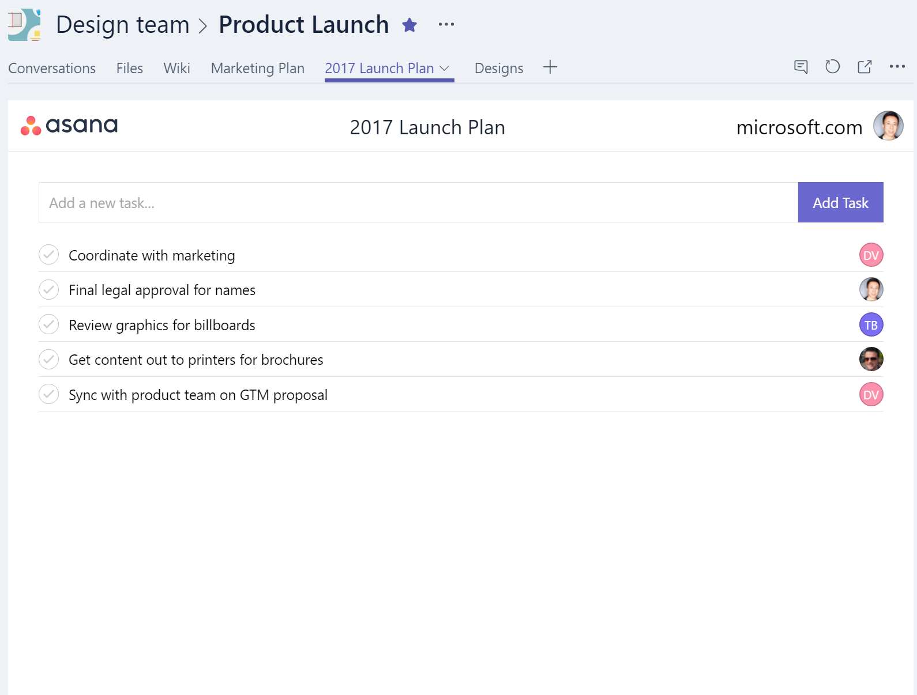
Tabs
Rich surface area for your app
As simple as hosting your existing web app
Team productivity: within channels
Personal productivity: app flyout
Your services, experience, & users

Slide 7


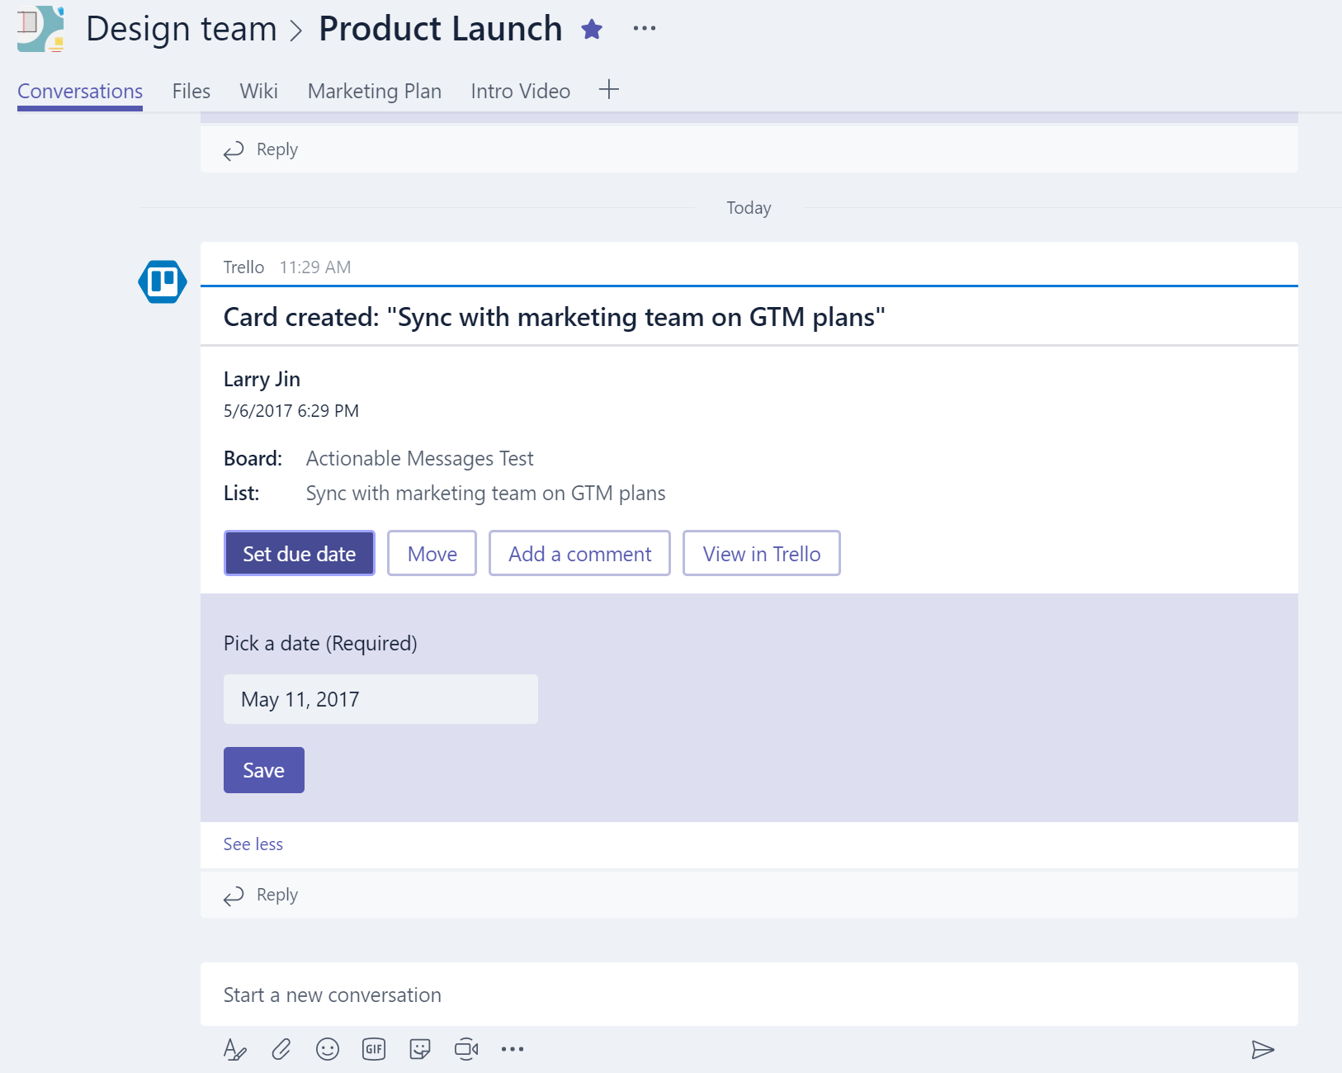
Connectors with Actionable Messages
Push rich interactive cards into channels
Users can take quick actions like comment, select options, set a date
Uses incoming webhook API
Fully supported in both Teams and Outlook

Slide 8


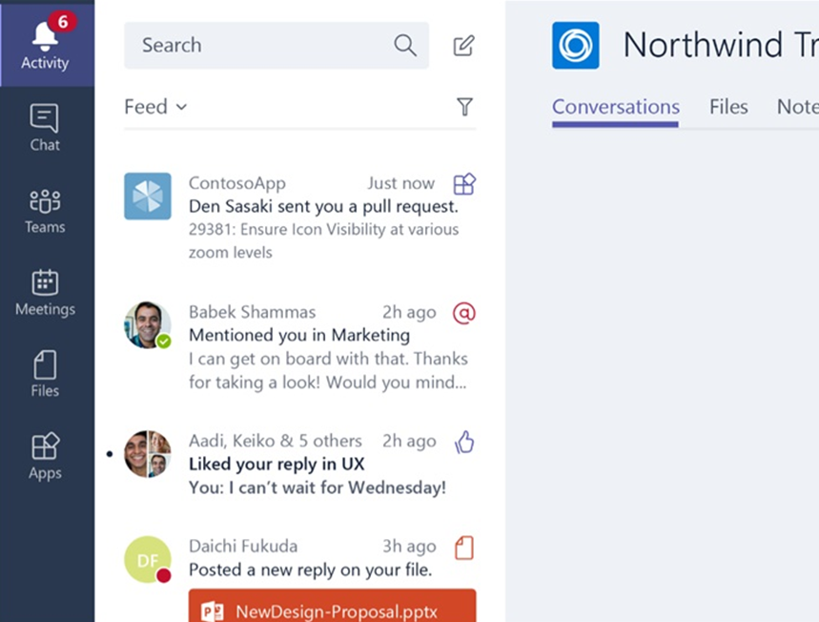
Activity feed
Notify users personally via the activity feed
Same API as sending bot messages
Deep link straight into tabs

Slide 9

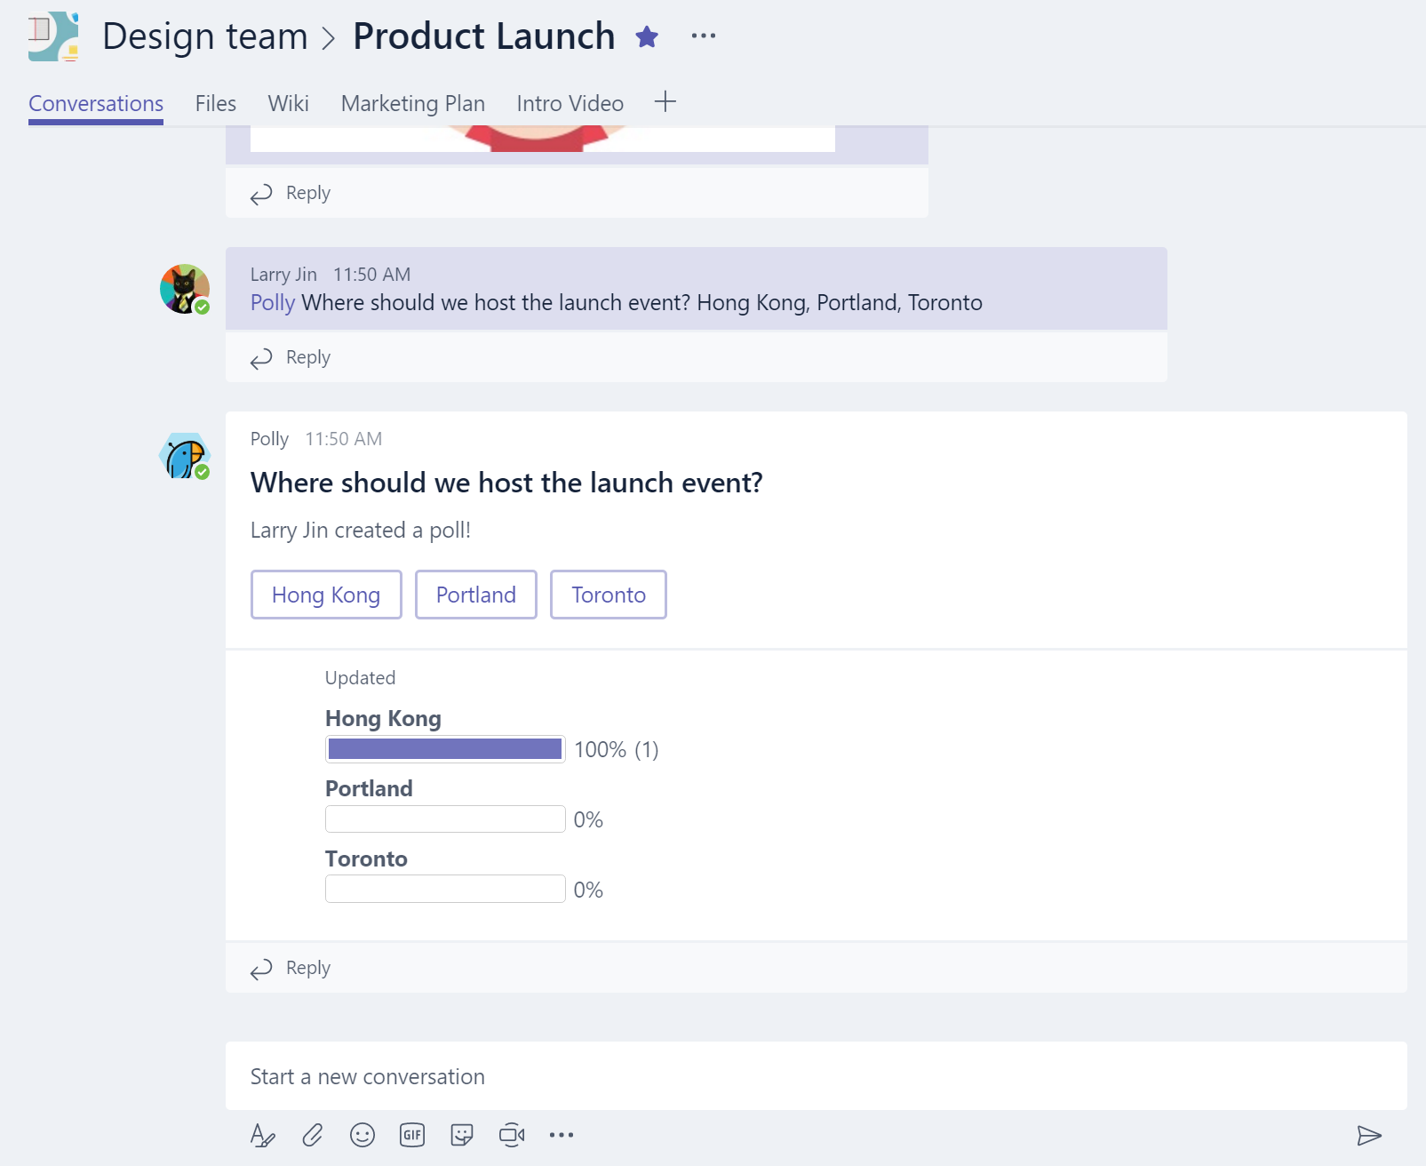
Bots
Bots make it easy for users to interact with your app in Team conversations or 1:1
Built using Microsoft Bot Framework
Complete tasks via basic commands, menu or natural language
Rich Microsoft Teams features, e.g.
Input menus
Dynamic message updates
Integrate with tabs

Slide 10

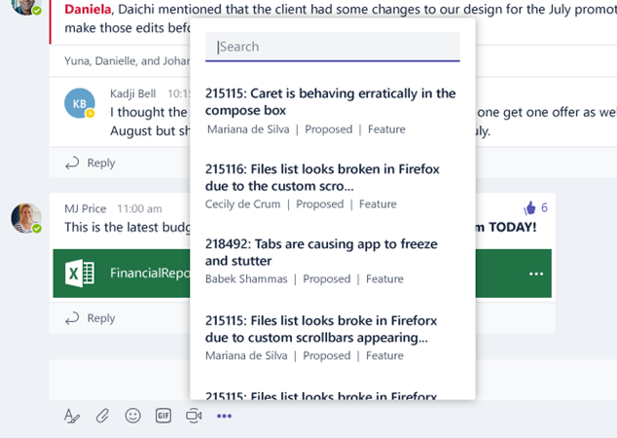
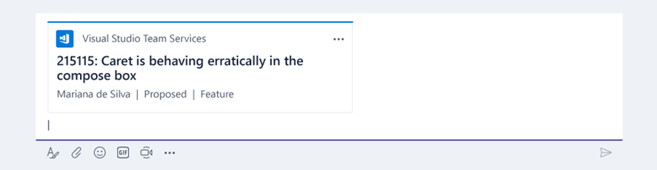
Compose Extensions
Personalize Teams Compose box with your App & Services content
Users can query and insert your app content into conversations
Example: Bug details from VSTS
Example: Sales opportunities from CRM
You can reuse services you built for Bots or Tabs

Slide 11
Tying it all together – Microsoft Teams App
Microsoft Teams Apps
With a single package, deliver one or more capabilities to end users, in contexts that make sense in your experience
Single App definition – manifest.json
Single package (.ZIP) used for Sideloading or Office Store submission

Slide 12

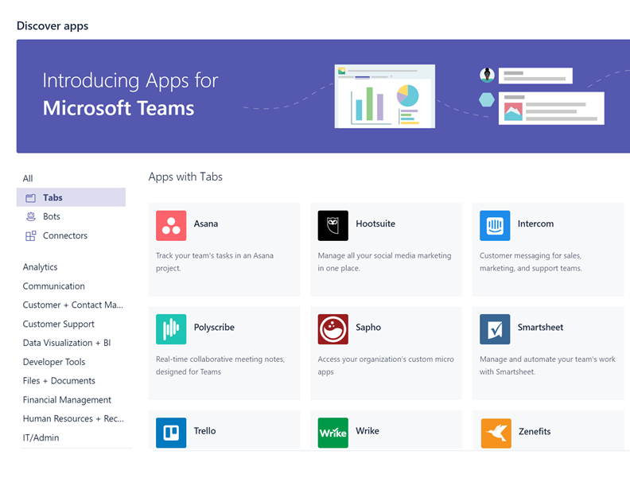
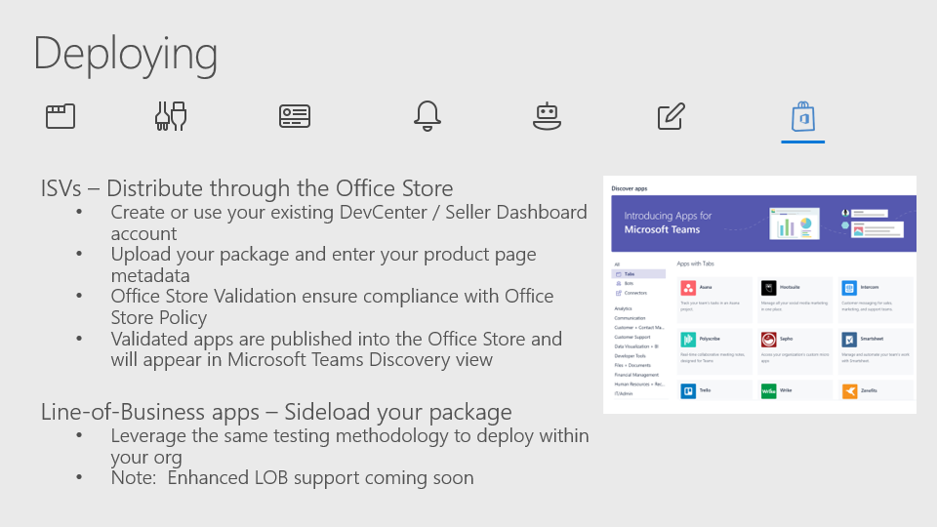

Microsoft Teams is open!
Register and submit your app today to the Office Store
Your app will be ready in the Developer Preview once approved

Slide 13
Building a Great Microsoft Teams app
Light up your experience how and where you want it:
Teams Scope - your experience exists in the team context
Team owners may add your experience to a team:
Bots and Compose Extensions – available on all channels
Teams Tabs (“Configurable”) – added and customized on a per-channel basis
Personal Scope – your experience exists in an individual user context
Individuals add the experiences they want for personal use
Bots and Compose Extensions – available in 1:1 chat
Personal Tabs (“Static”) – available to end users via the App bar or alongside 1:1 bots

Slide 14
Getting Started
Tabs - Bring your own Service
Light-weight Javascript APIs to tie your experience to Teams context
Connectors – Leverage the Connectors Developer Portal
Build once, run on both Outlook and Teams
Use new Actionable Cards layouts
Bots – Build using the Bot Framework
Use the .NET and Node.js SDKs, or call the REST endpoints with your language of choice
Teams Extension SDKs facilitate easy access to Teams-specific functionality
Flag important messages for inclusion in Activity Feed
Compose Extensions – Reuse your bot
Use the .NET and Node.js SDKs, or call the REST endpoints with your language of choice
Teams Extension SDKs facilitate easy access to Teams-specific functionality

Slide 15
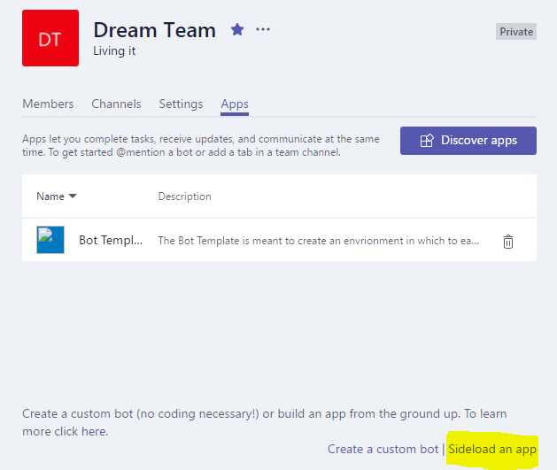
Testing and hosting
These are your services, hosted by you, in your cloud
Build, test, deploy are your processes
For testing within Microsoft Teams, create an Apps package, and sideload into a team

Slide 16
Deploying
ISVs – Distribute through the Office Store
Create or use your existing DevCenter / Seller Dashboard account
Upload your package and enter your product page metadata
Office Store Validation ensure compliance with Office Store Policy
Validated apps are published into the Office Store and will appear in Microsoft Teams Discovery view
Line-of-Business apps – Sideload your package
Leverage the same testing methodology to deploy within your org
Note: Enhanced LOB support coming soon

Slide 17
Tabs

Slide 18
Tabs
Embed-ready web UX on web/desktop, deep link to native apps on mobile
Leverages Microsoft Teams Tab Library javascript for context and interactivity
Team or Personal Scope

Slide 19
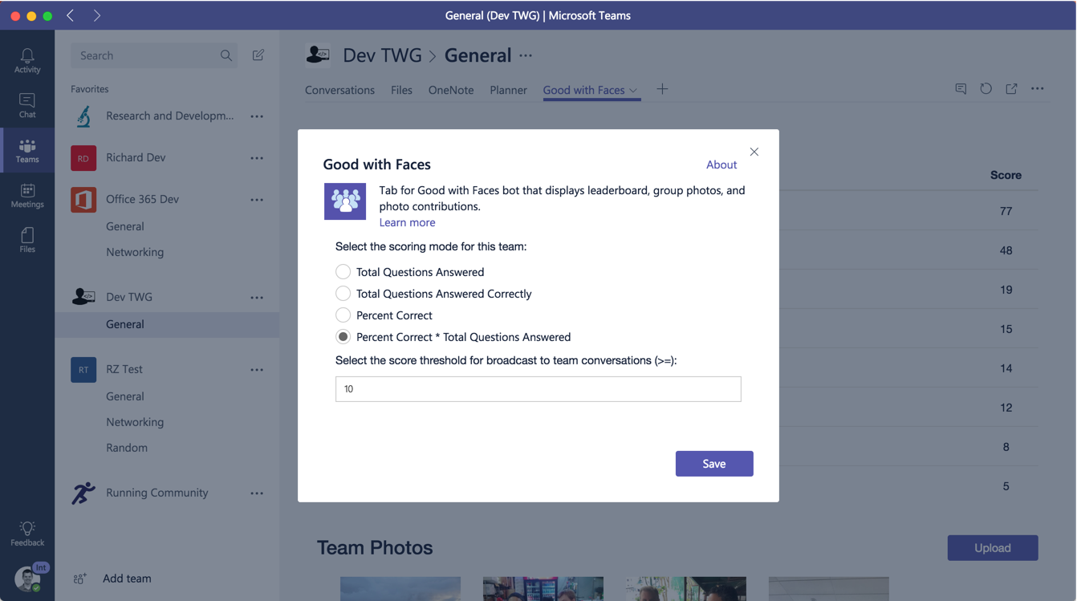
Tabs Pages
Configuration Page: page used to add or update the tab and set content page
Content Page: the primary page displayed in the tab
Remove Page: optional page displayed when a tab is removed

Slide 20
Tabs - Config Page
Used to add/edit a tab
Must reference Microsoft Teams Tab Library
Sets the contentUrl for the tab
Calls setSettings to save tab configuration
Must call setValidityState to enable the save button and notifySuccess when saved
microsoftTeams.initialize();
microsoftTeams.settings.registerOnSaveHandler(function(saveEvent){
microsoftTeams.settings.setSettings({
entityId: "someid",
contentUrl: "https://somedomain/tab.html",
suggestedDisplayName: "Tab Title",
websiteUrl: "https://somedomain/info.html",
removeUrl: "https://somedomain/tabremove.html"
});
saveEvent.notifySuccess();
});
function onSaveClick() {
microsoftTeams.settings.setValidityState(true);
}

Slide 21
Tabs - Context information
getContext returns team/channel context:
tid – id of tenant
groupId – id of the O365 group
teamId – id of the team
channelId – id of the channel
entityId – id of the entity
theme – theme of the teams client
locale – the locale of the client
upn – UPN of the user
microsoftTeams.getContext(function (context) {
// context contains all context info
});

Slide 22
Tabs - Deep linking to Entities
Share a Link from your Tab
Trigger the creation of a deep link to a specific Entity for a user to copy / paste into a conversation.
Resultant link may be clicked on by any user to launch the tab and navigate directly to that Entity.
Generate your own Deep Link
Programmatically create your own link, for use via bot or other code flows.
microsoftTeams.shareDeepLink({
subEntityId: <subEntityId>,
subEntityLabel: <subEntityLabel>,
subEntityWebUrl: <subEntityWebUrl>
})
https://teams.microsoft.com/l/entity/
<appId>/<entityId>
?webUrl=<entityWebUrl>
&label=<entityLabel>
&context=<context>

Slide 23
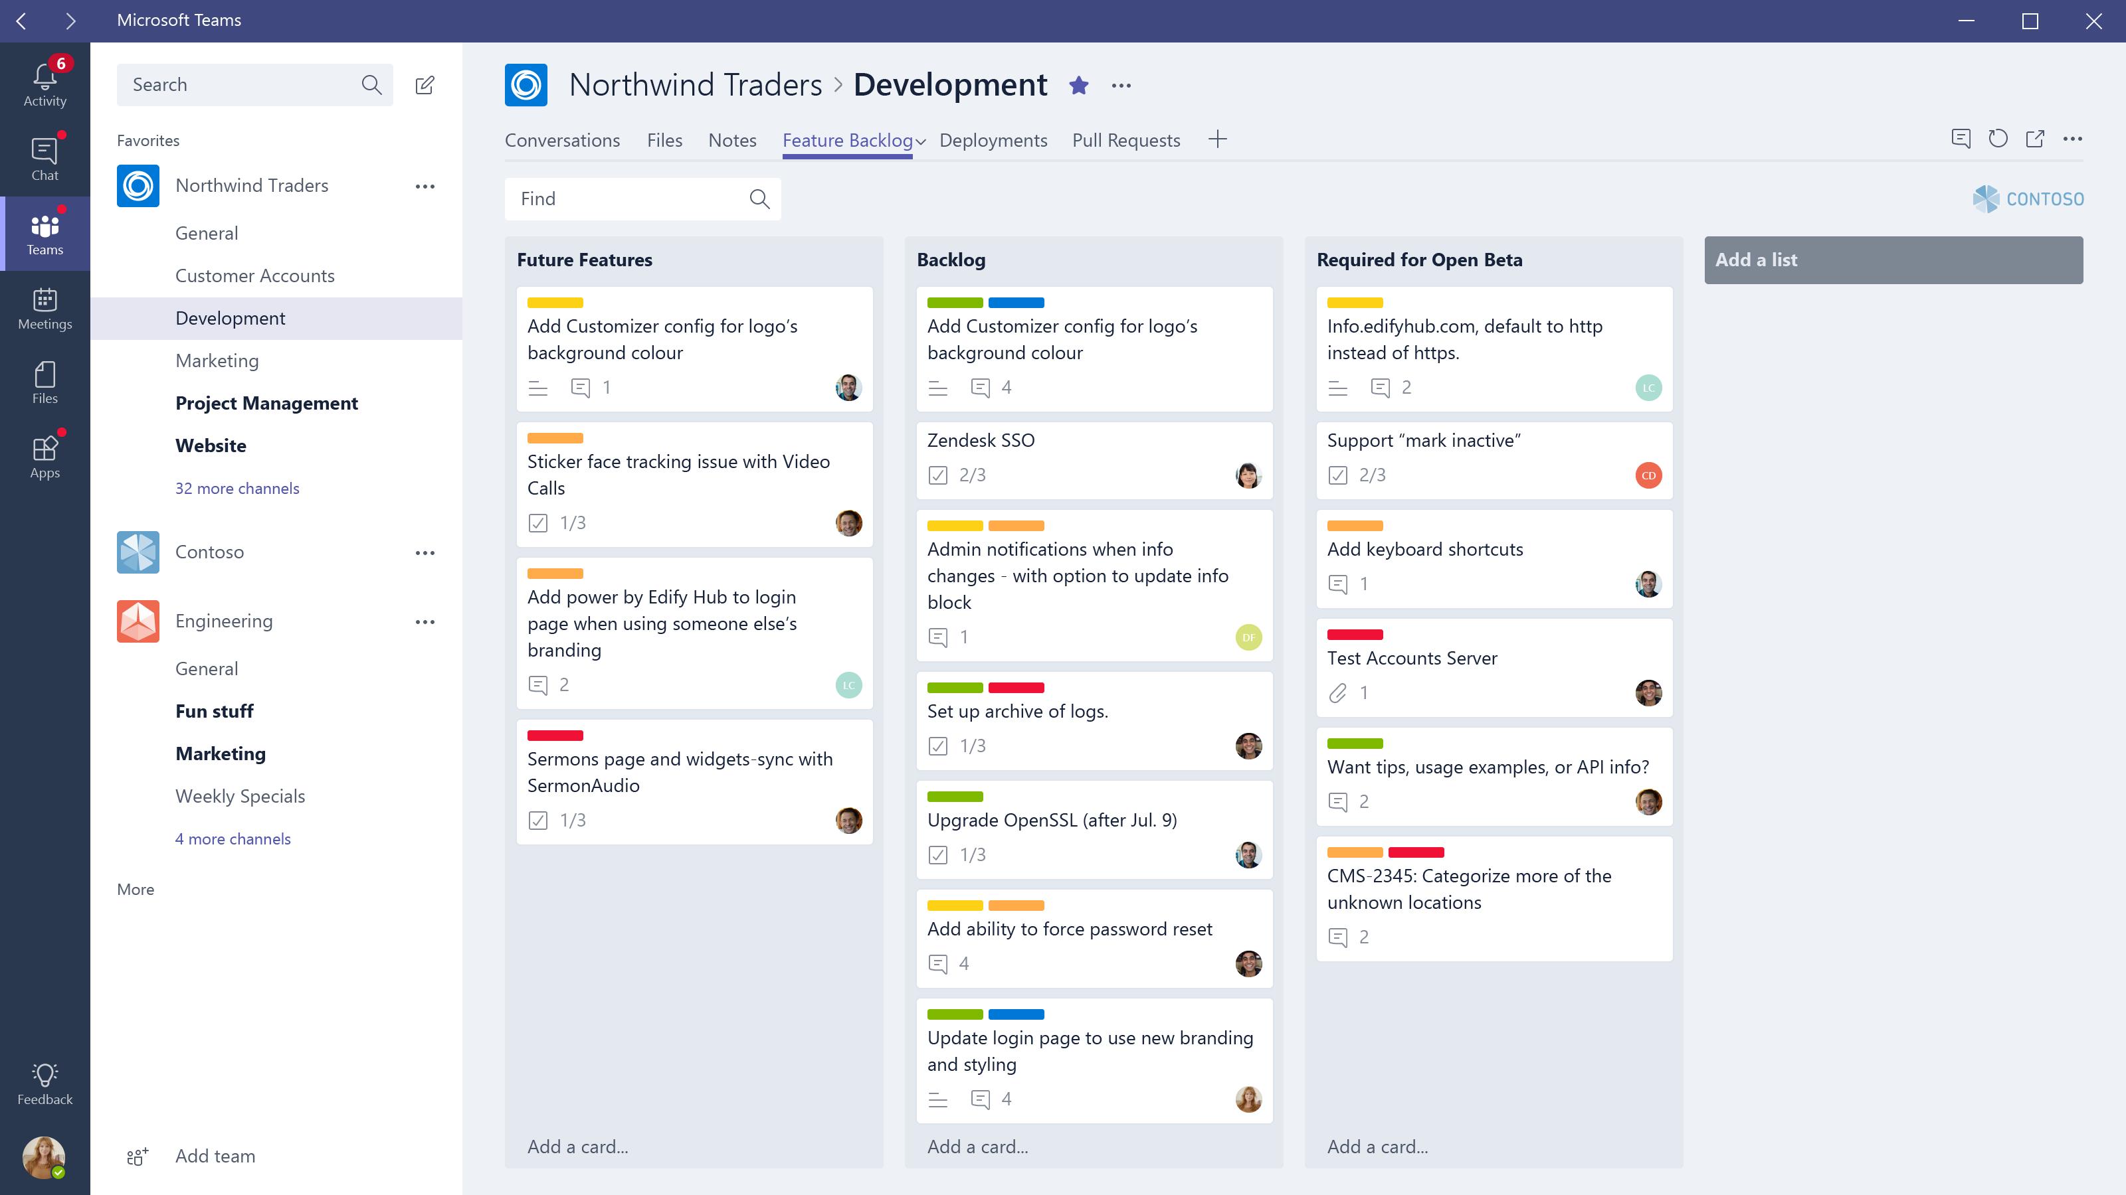

Slide 24
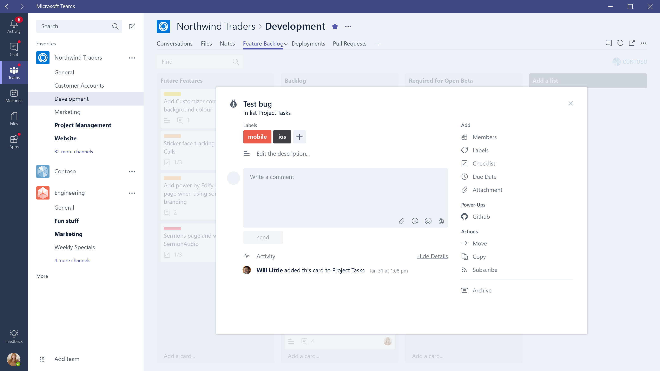

Slide 25
Building a Great Tabs experience
Tabs in Microsoft Teams
Put information at the fingertips of users
Leverage collaborative nature of the product
Minimize context switching – easy to find what users needs
Focus on content that makes sense in the solution
Minimize extra chrome – focus on what you want the user to do
Design for bite-size tasks – power users should use your full SaaS

Slide 26
Building a Great Tabs experience
Configurable Tabs
In a channel, tabs should allow the user to configure the view to the relevant content
Content should be the same for all users – leverage collaboration
Content should be locked – don’t allow users to browse away
Static Tabs
In personal scope, this content should be the relevant for either the all-up app (e.g. Help, FAQ, forums) or for a personal view of the experience

Slide 27
Bots

Slide 28
Bots
Web Service you create and host, using whatever web technology you prefer (though we recommend Node.js or .NET on Azure)
Built using Microsoft Bot Framework, leverage other tech like LUIS
Node.js and .NET/C# libraries, or call REST APIs directly
New Microsoft Teams Extension libraries (Node.js and .NET) facilitate channel-specific functionality

Slide 29
Bots – Getting up and running
Set up basic development environment and install Bot Builder and Microsoft Teams extension SDKs for chosen language
Leverage existing Bot Framework sample or Teams Getting started sample
Run locally in the Bot Emulator

Slide 30
Bots - Getting Teams-ready
Register your bot in the Bot Framework Dev Portal
Set a unique bot name and handle
Set your bot Endpoint – your hosted domain, or your debug instance (we recommend Ngrok)
Create an AppID (aka BotID) and Password
Add Microsoft Teams as a Channel
Note: for 1:1 bot, you may reference your bot directly via its AppID
Enter your AppID and Password into your Development environment
Build and publish or run locally with Ngrok

Slide 31
Bots - Accessing in Teams
{
"manifestVersion": "1.0",
"version": "1.0.0",
“id": "%APP_GUID%",
"packageName": "com.samples.samplebot",
"developer": {
"name": "Microsoft",
"websiteUrl": "https://www.microsoft.com",
"privacyUrl": "https://www.microsoft.com/privacy",
"termsOfUseUrl": "https://www.microsoft.com/termsofuse"
},
"name": {
"short": "Sample Bot App"
},
"description": {
"short": "This is a sample bot manifest",
"full": "This is a sample bot manifest that has the bare minimum you need for a bot, which will work in Teams and Personal scopes."
},
"icons": {
"outline": "contoso20x20.png",
"color": "contoso96x96.png"
},
"accentColor": "#60A18E",
"bots": [
{
"botId": "%BOT_FRAMEWORK_ID%",
"scopes": [
"team",
"personal"
]
}
],
"permissions": [
"identity",
"messageTeamMembers"
]
}
Create a Teams App Manifest
We have provided a SimpleBot package in MSDN – a basic bot manifest with sample icons
Add your BotID in the Bots object
Sideload into a Team

Slide 32
Bot - Messaging
Responsive messages (via 1:1 or @mentioning in channel)
Proactively create messages
Create direct (1:1) message – must know user ID
Create new channel reply – bot must be added to team and know channel information
Update messages sent by Bot
One-way only – e.g. push notifications

Slide 33
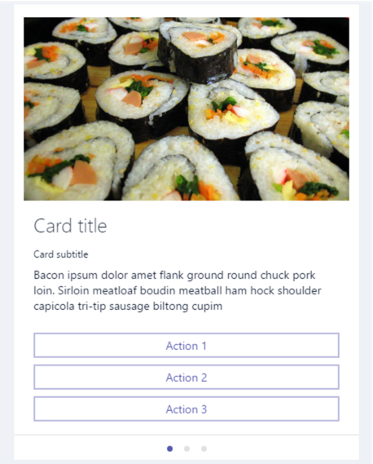
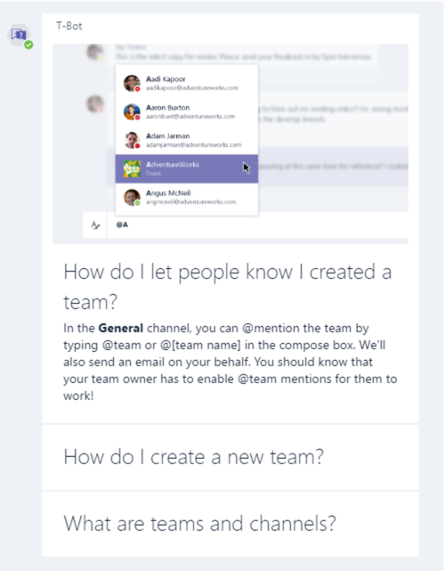
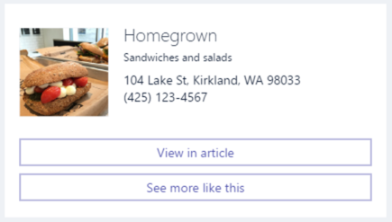
Bot - Content
User to bot
Plain or rich text
Inline images
Note: files not currently supported
Bot to user
Plain text
Markdown or XML
Cards
Hero Cards
Thumbnails
Sign-in
Carousel or List layouts
Buttons
openUrl – open in browser
imBack – trigger chat response
invoke – silent JSON payload

Slide 34
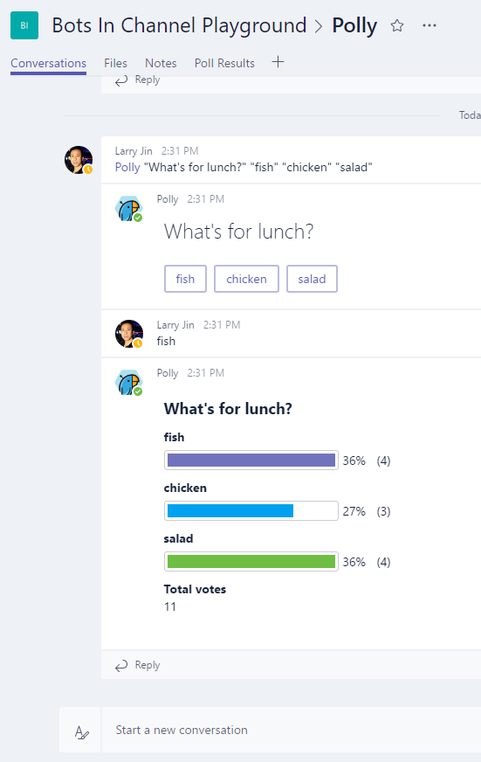
Bots in team channels - Basics
Bot only listens to @mentions
Replies go to the conversation thread
Inbound payload in channels as flagged as isGroup and contains Teams channel data:
"channelData": {
"channel": {
"id": "19:293ecdb923ac4458a5c23661b505fc84@thread.skype",
},
"team": {
"id": "19:293ecdb923ac4458a5c23661b505fc84@thread.skype"
},
"tenant": {
"id": "72f988bf-86f1-41af-91ab-2d7cd011db47"
}
}

Slide 35
Bots in team channels – Special functions
Retrieve a list of all team members, including:
Name
Email
AAD Object
UPN
Retrieve a list of all channels
@Mentioning users
Proactively create New Reply chain
Team/channel event monitoring
User addition/remove
Channel creation/removal/renaming

Slide 36
Building a Great Bot experience
Bots in Microsoft Teams
Whether used as a CLI for your SaaS, or a conversation bot to facilitate work, create the experience that makes the most sense for your product.
Take advantage of scope to provide the appropriate information in channel or via 1:1.
Leverage the Bot Framework and Microsoft Teams Extension SDK to gain insight to the team and channel, or act as an intelligent notification system.
Leverage Static Tabs to provide additional help and user education, right alongside the chat stream.

Slide 37
Compose Extensions

Slide 38
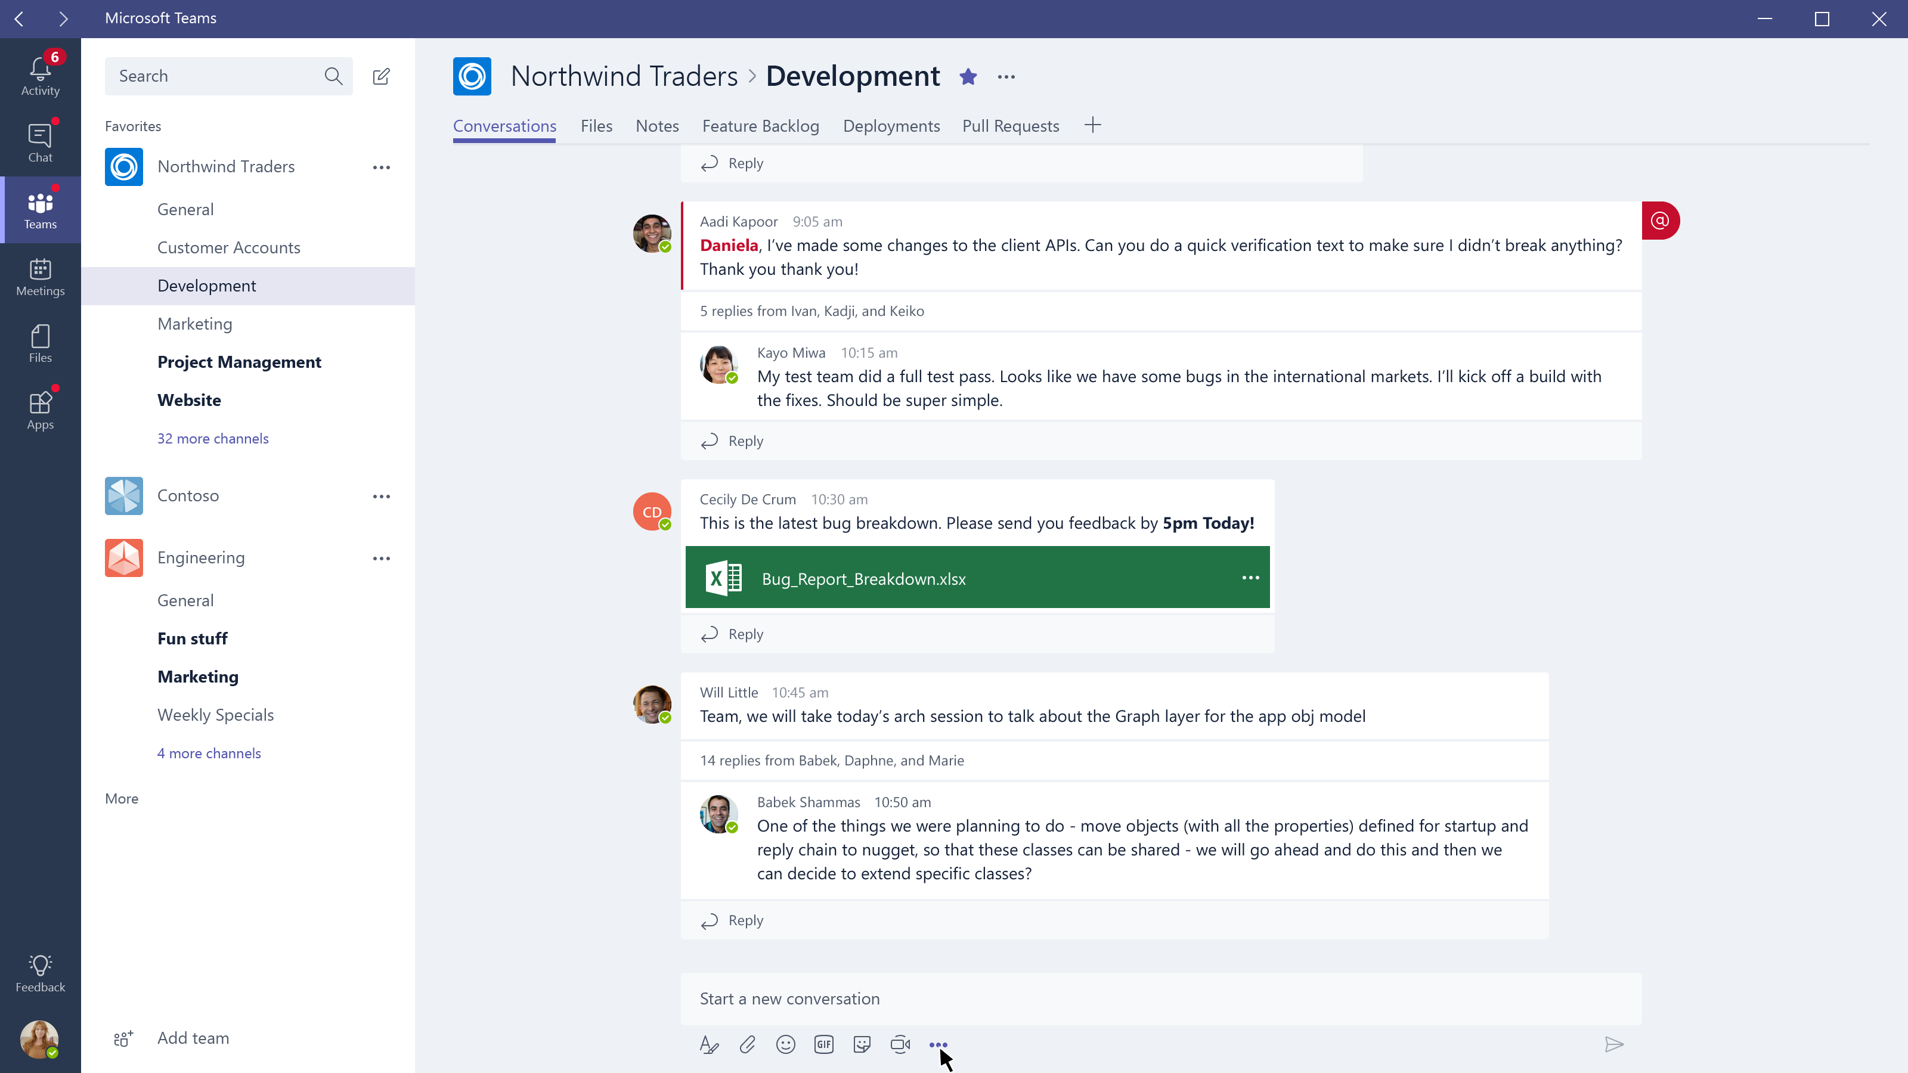

Slide 39
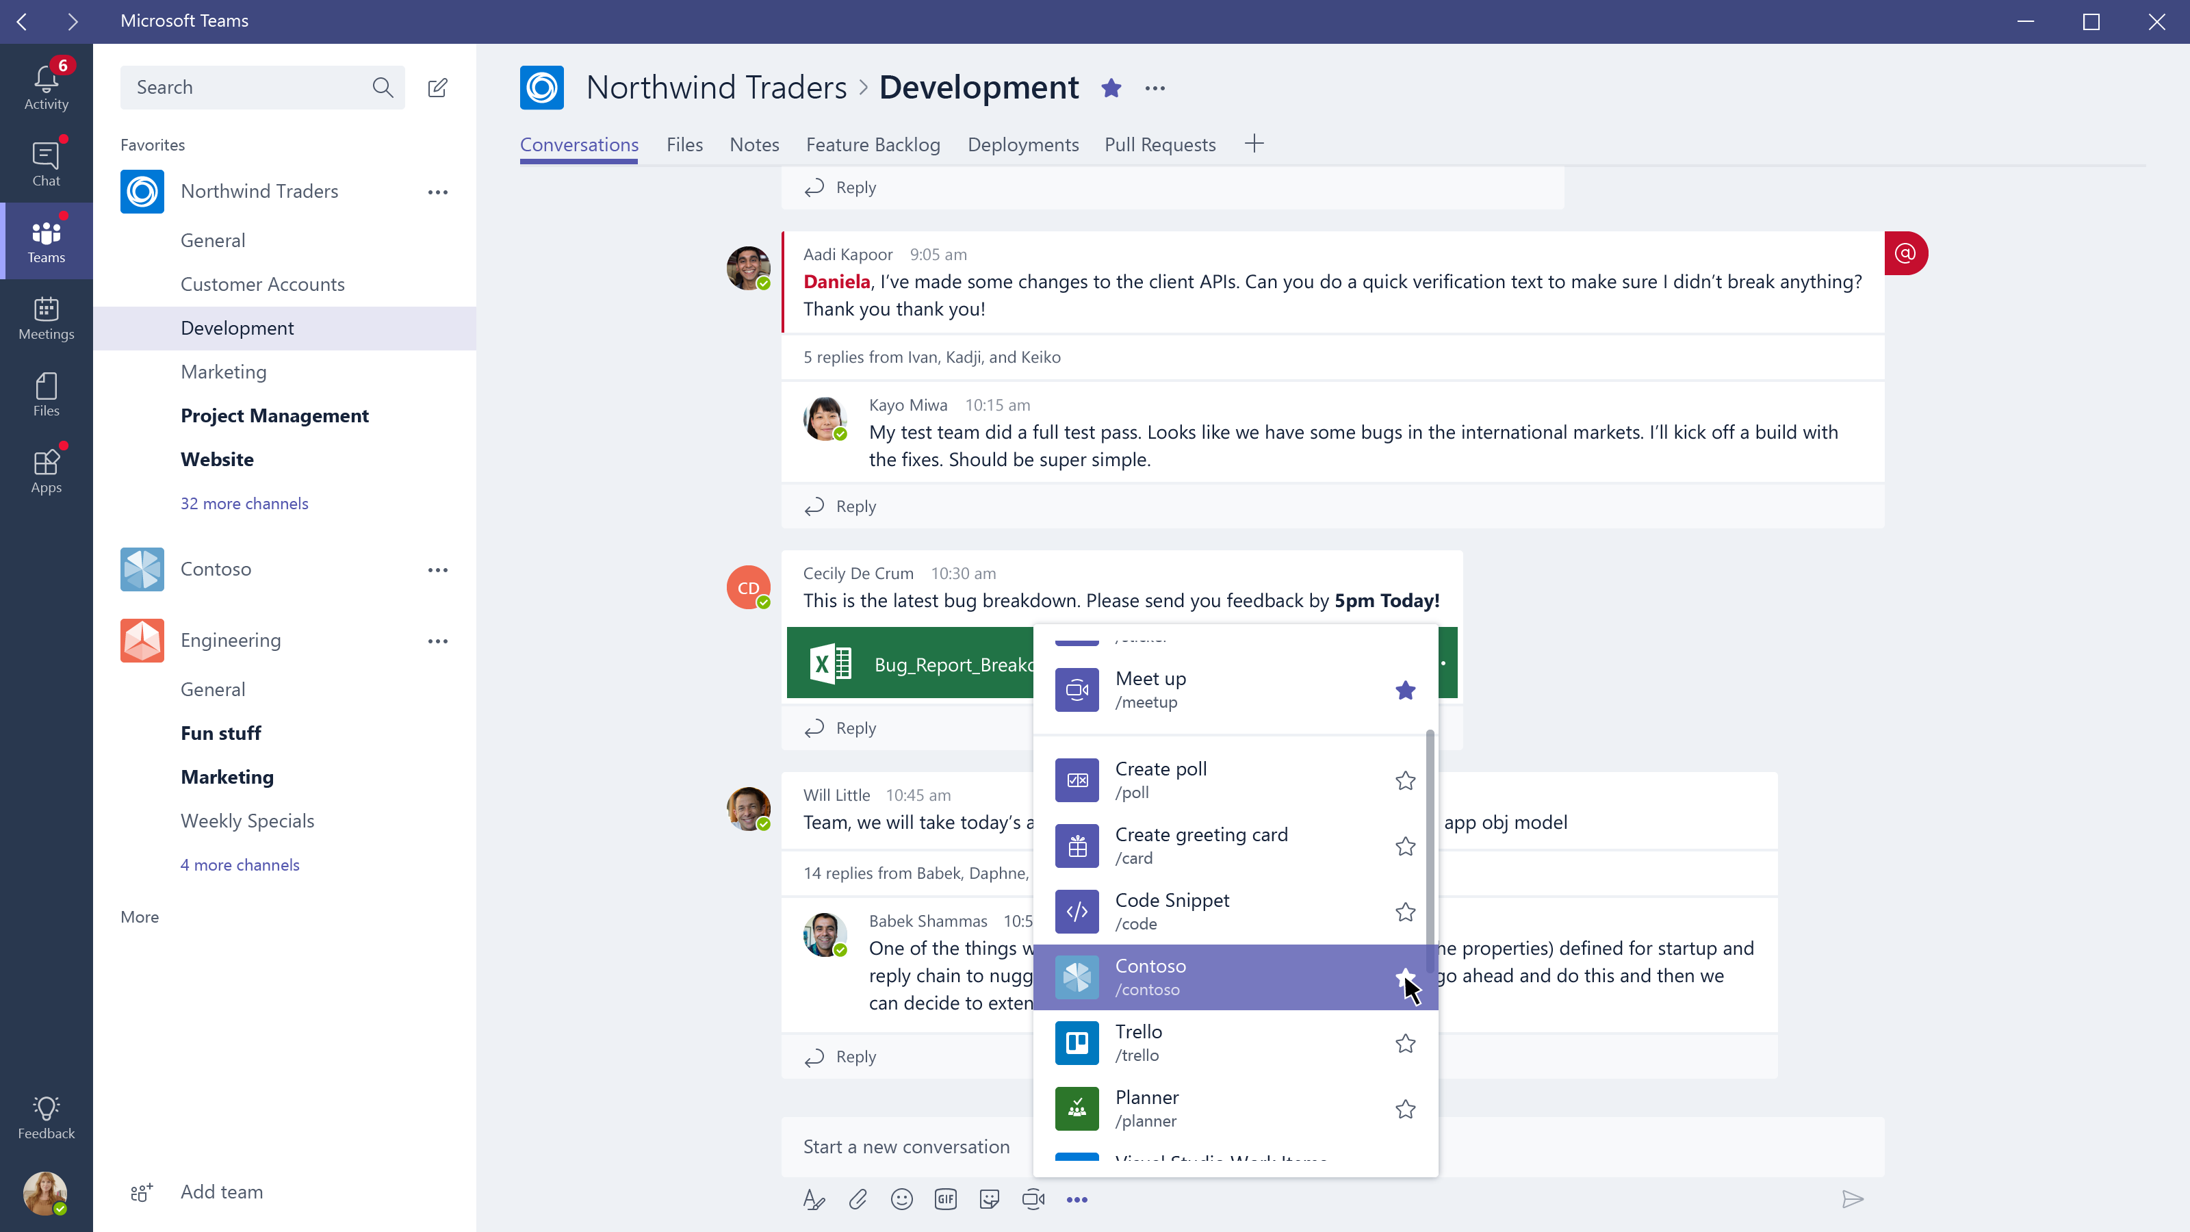

Slide 40
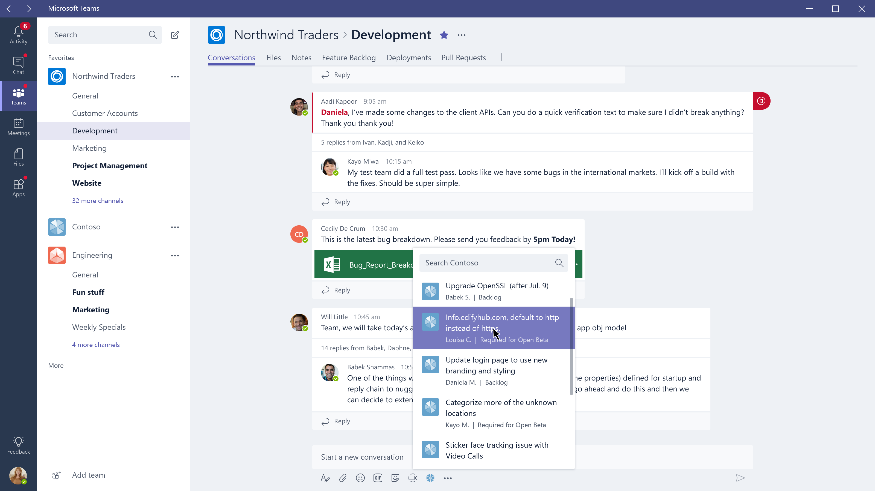

Slide 41
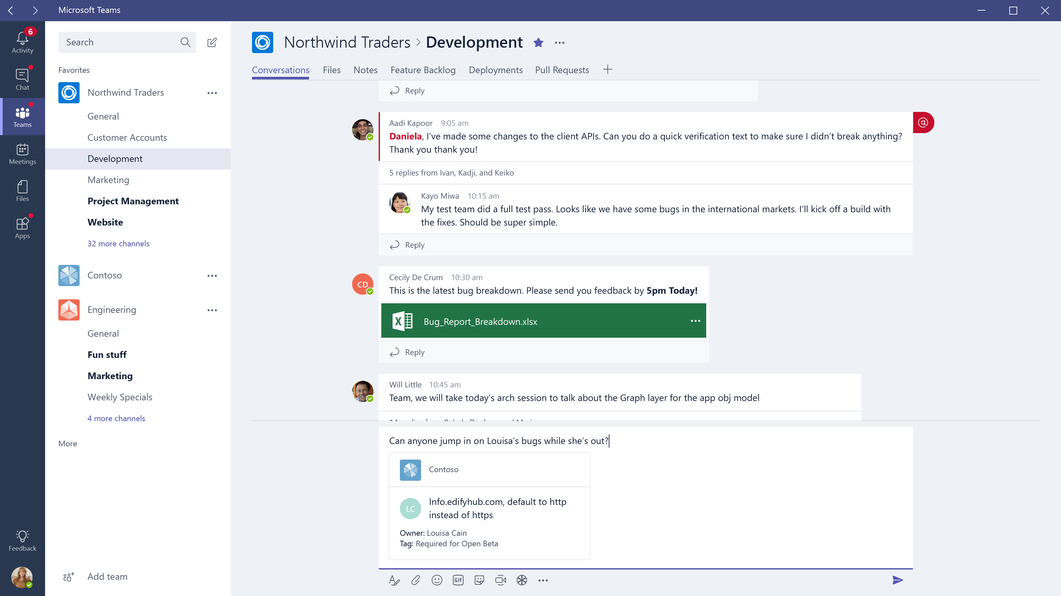

Slide 42
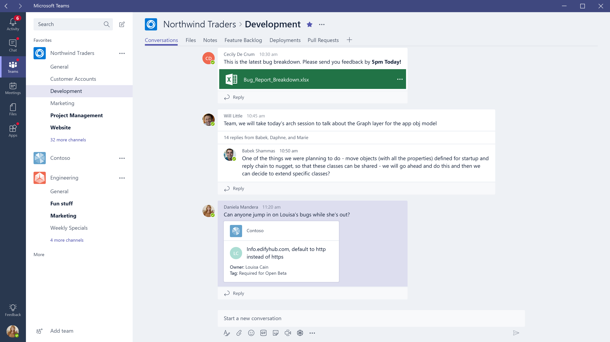

Slide 43
Compose Extensions
Cloud-hosted service that listens to user requests and responds with cards or rich media
Leverage the Bot you’ve already built, or build another
Define commands and parameters in the manifest.json
Handle via Bot Framework activity, leveraging the Microsoft Bot Extension SDKs
"composeExtensions": [
{
"botId": "57a3c29f-1fc5-4d97-a142-35bb662b7b23",
"scopes": [
"personal"
],
"commands": [{
"id": "searchCmd",
"description": "Search Bing for information on the web",
"title": "Search",
"initialRun": "true",
"parameters": [{
"name": "searchKeyword",
"description": "Enter your search keywords",
"title": "Keywords"
}]
}
]
}
],
(Snippet)

Slide 44
Building a Great Compose Extension experience
Compose Extensions in Microsoft Teams
Share content that makes sense in conversations.
Add on as part of your core Bot offering to facilitate easier management.
Take advantage of the rich card types provided as part of the platform.
Optimize search results to keep compose extensions snappy and responsive.

Slide 45
Connectors

Slide 46
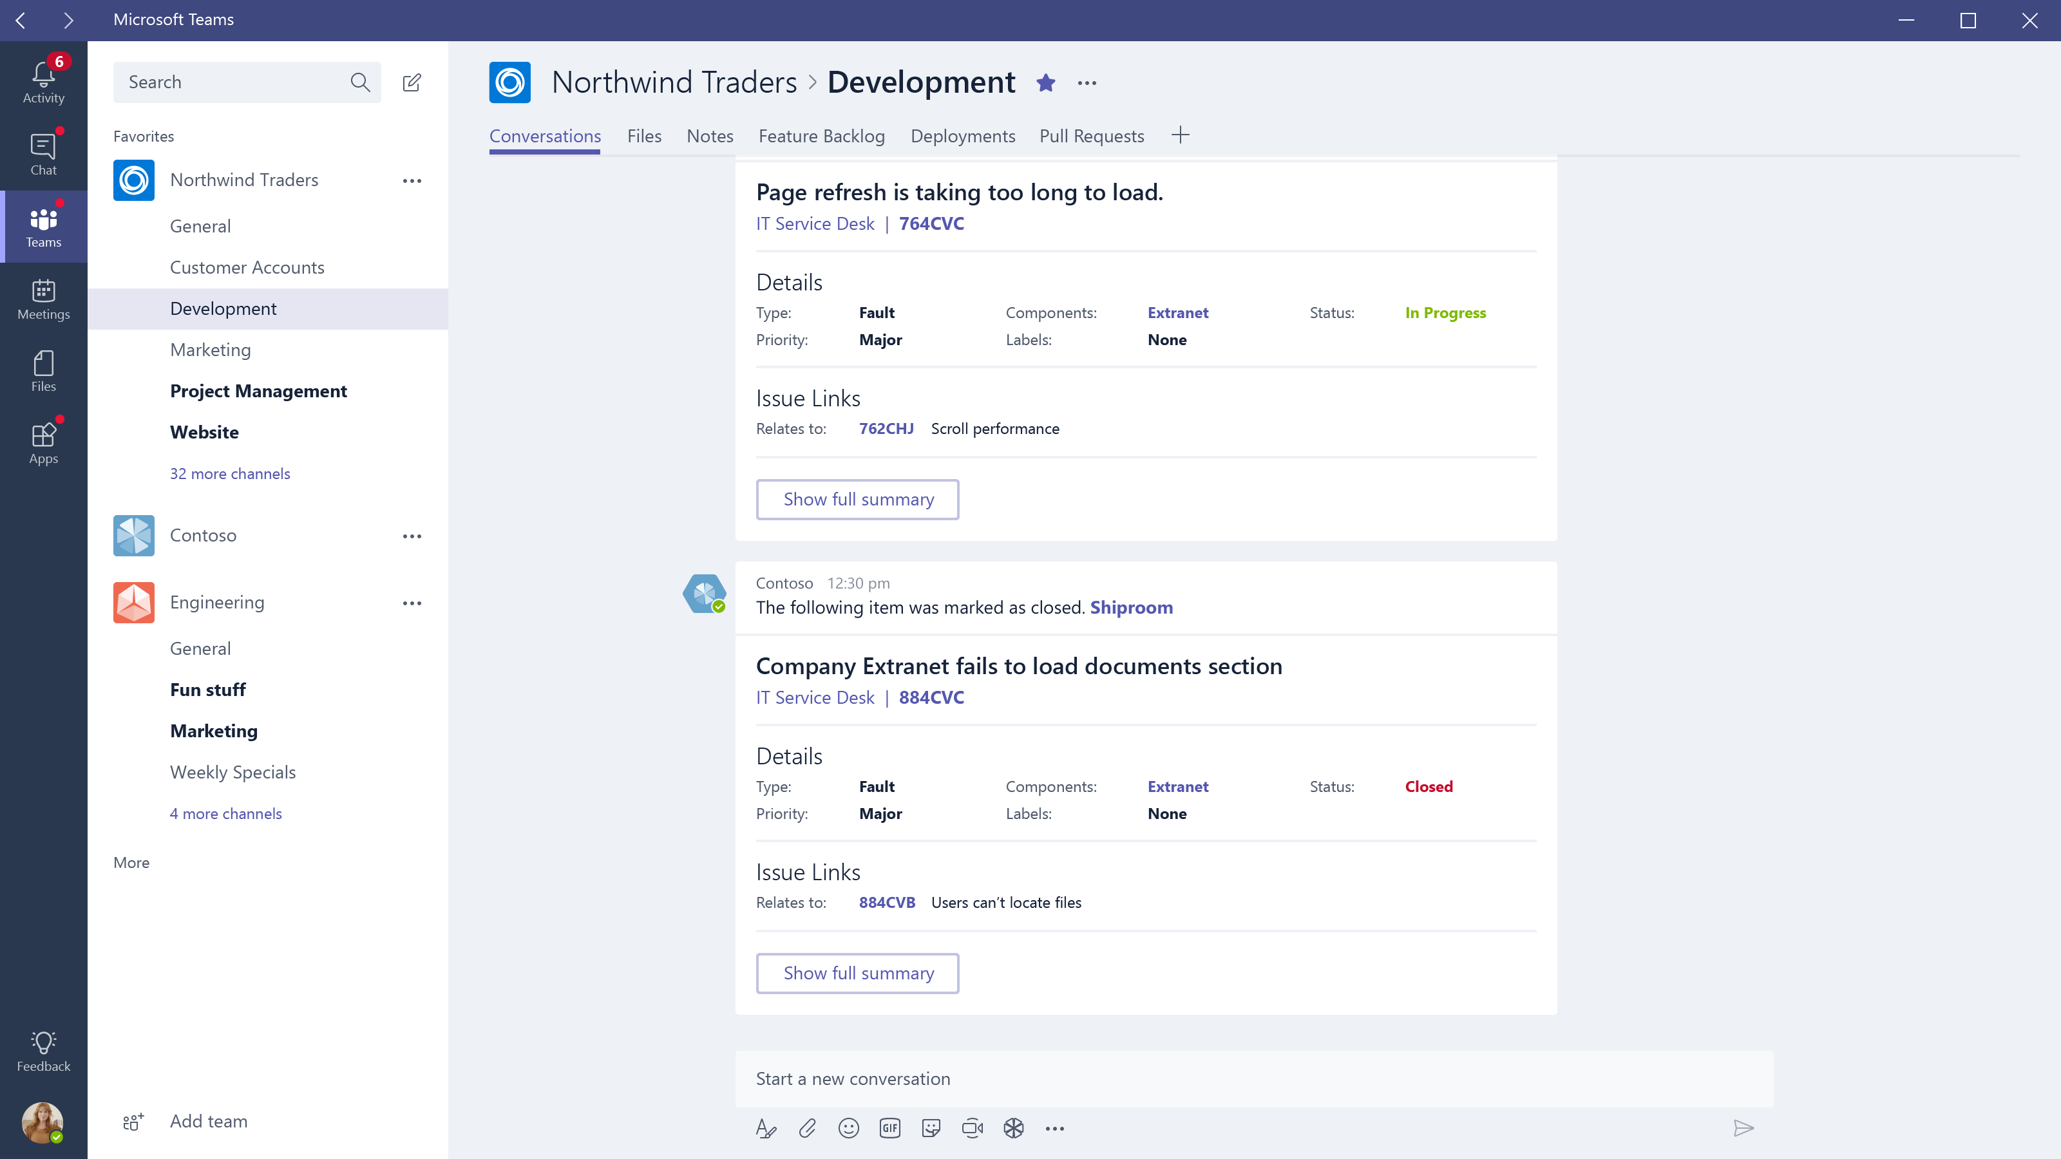

Slide 47
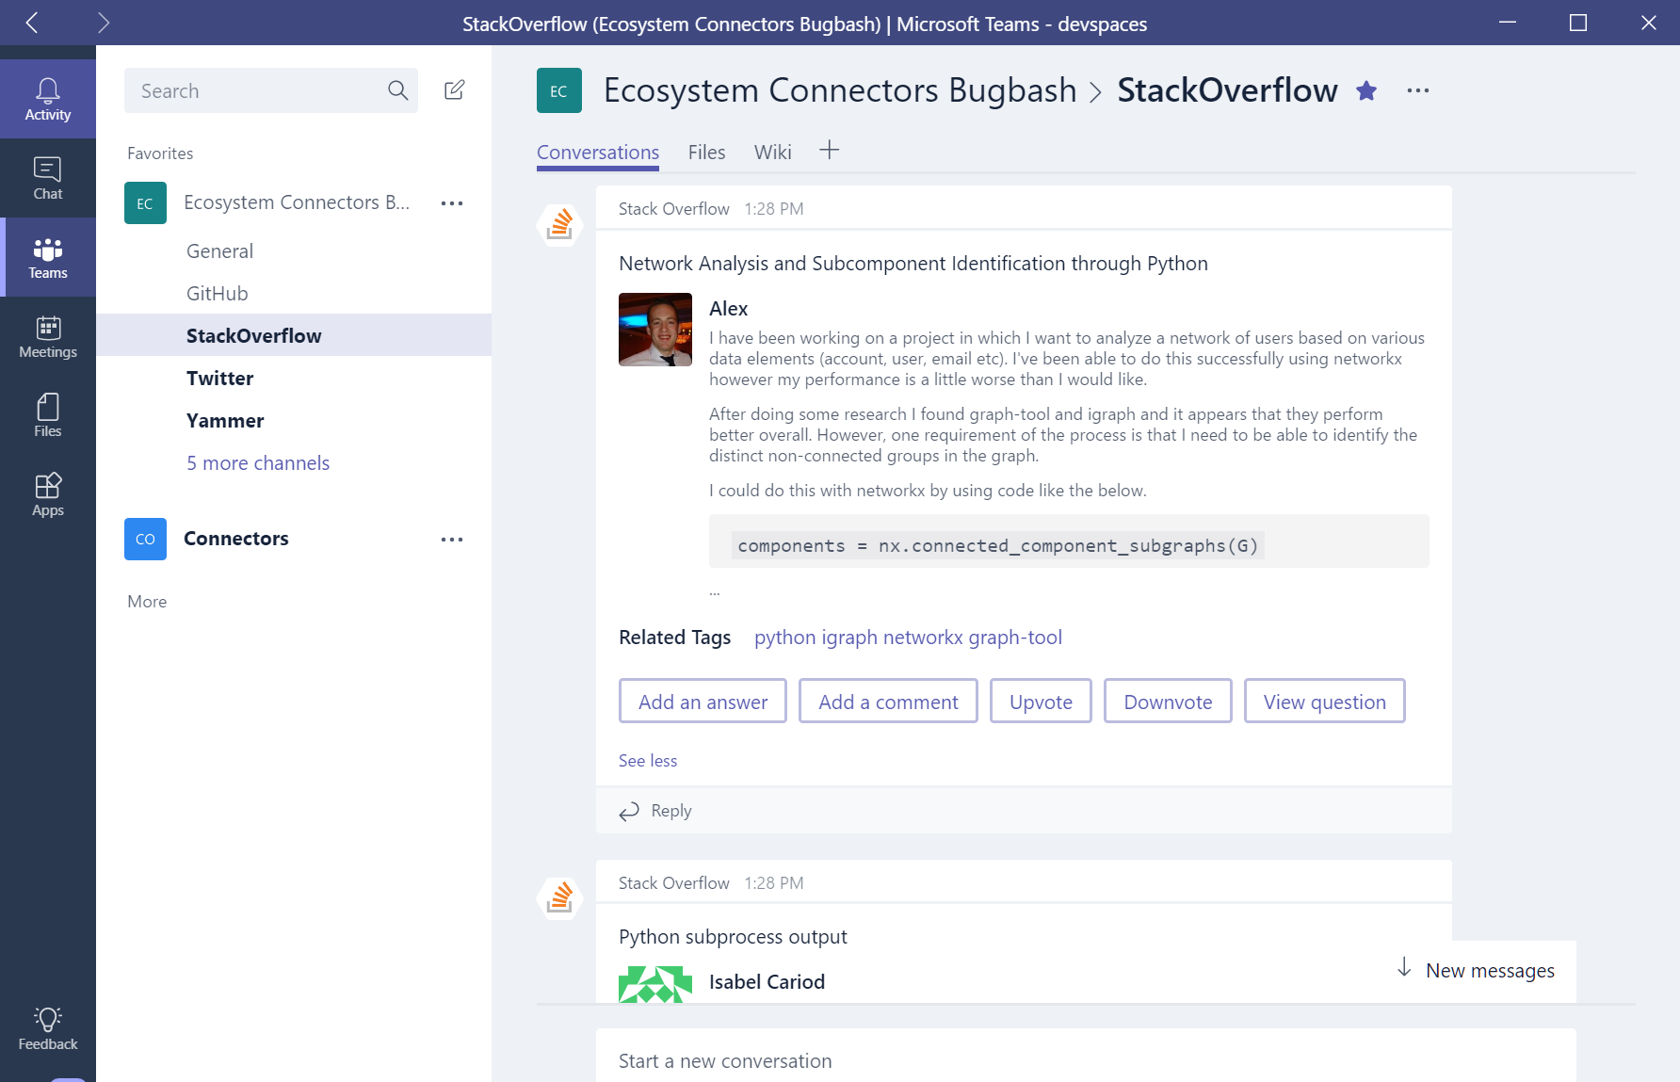
Office 365 Connectors
Leverage webhooks to send activity into Teams
Build your own connector, registering on the Connector Developer Portal
Simply add Connector ID to manifest.json
Leverage new Actionable Messages, to allow users to get inline work done

Slide 48
Activity Feed

Slide 49
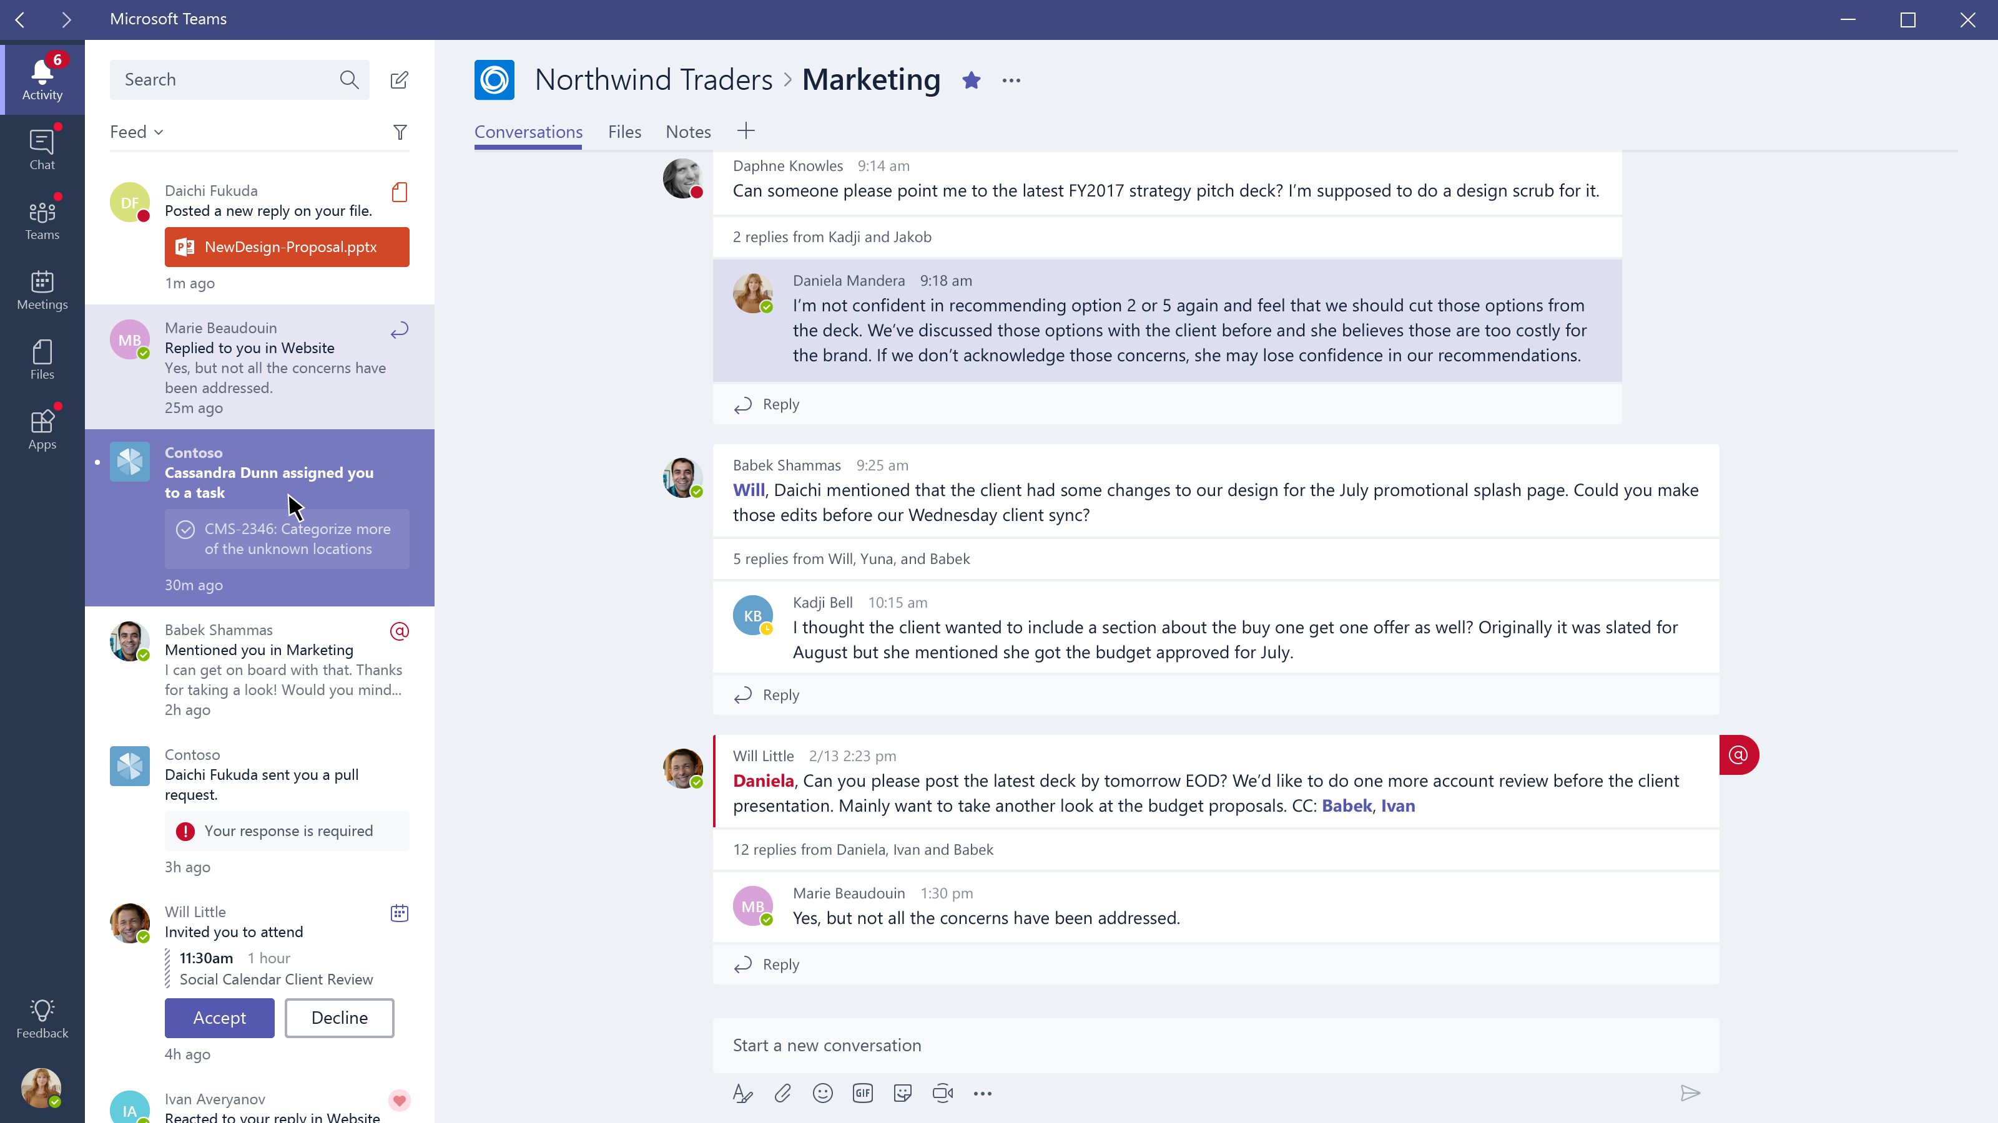

Slide 50
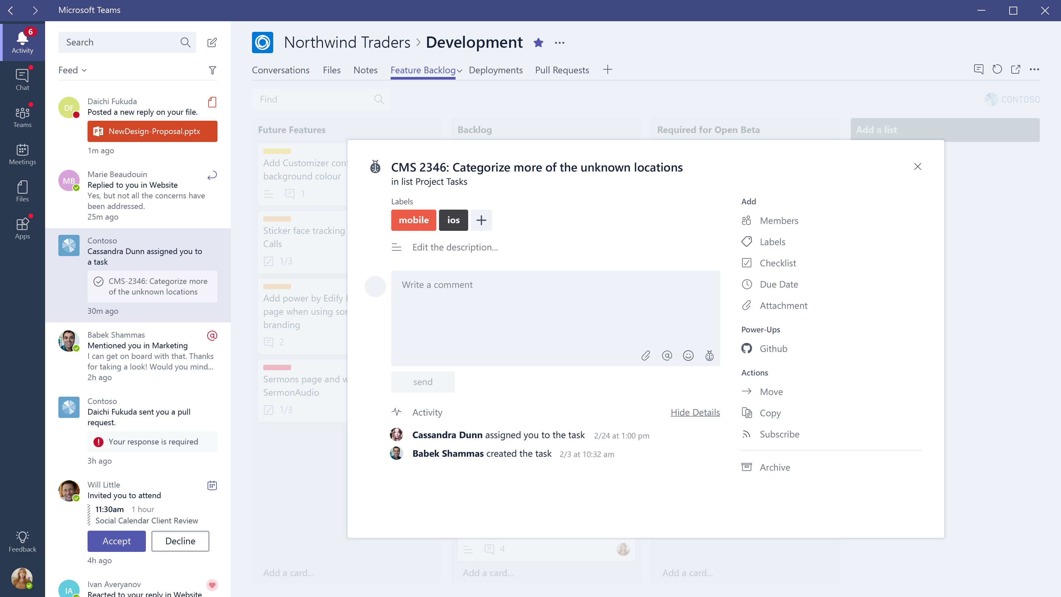

Slide 51
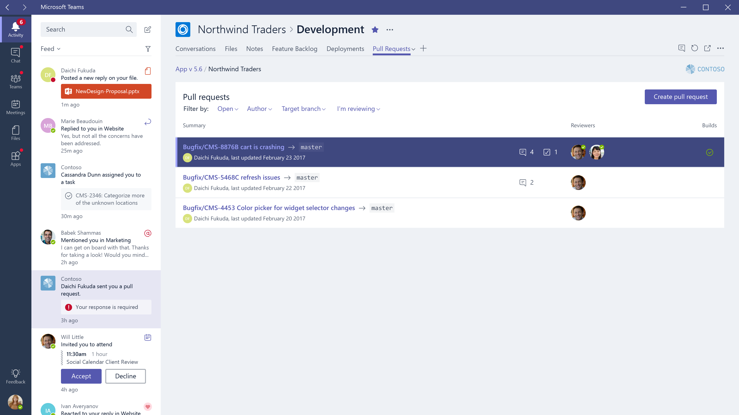

Slide 52
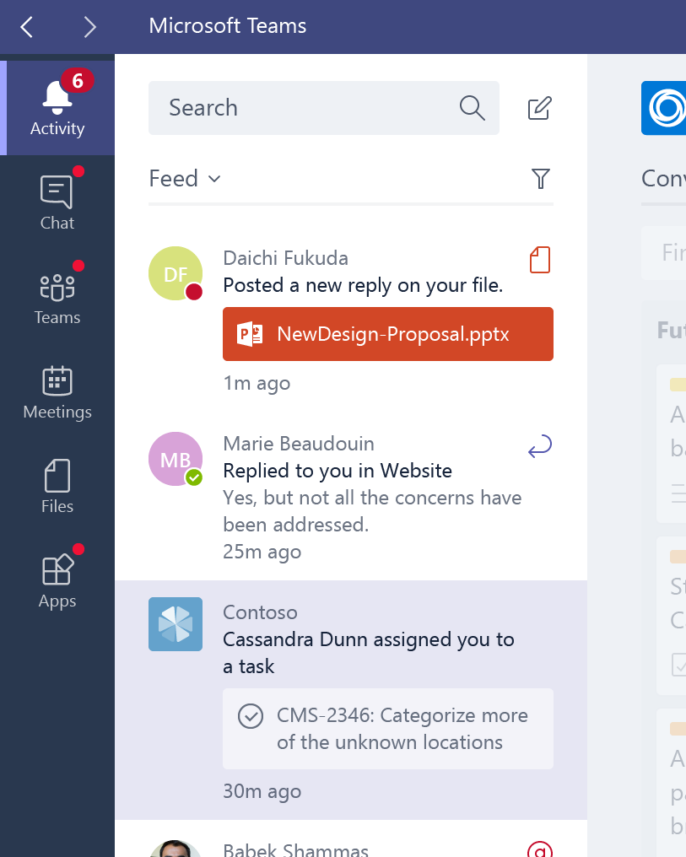
Activity Feed
Use the Activity Feed to send important information to your users
Leverage your existing Bot, to tag specific messages as notification alerts
Encode a deep link to your entity (tab) to allow one-click navigation to your content

Slide 53
Putting it all together

Slide 54
Building a Great Microsoft Teams app
Channel Tabs Sharing group information Pin information or tools important for the channel | Connectors Simple push notifications across channels (Outlook & Teams) | Notifications Get work done inline Keep users focused on tasks that matter | Channel Bots Coordinate the group Broadly share Push notifications | Compose Extensions Provide contextual shortcuts to information users need
Personal Tabs Focus on the user Provide help or other information |  |  | Personal Bots Simplify commands Q&A Provide individual insight

Slide 55
Building a Great Microsoft Teams CRM app
Channel Tabs Team account list Target / metrics dashboard | Connectors Simple push notification from other tools | Notifications Flag important action items | Channel Bots Channel notifications of wins / losses In-group opportunity queries | Compose Extensions Quick way to send links to opportunities
Personal Tabs Filtered account list Personal dashboard |  |  | Personal Bots Personal queries

Slide 56
Building a Great Microsoft Teams project app
Channel Tabs Project Kanban Task list Project schedule Burndown chart Other dashboards | Connectors Simple push notification from other tools | Notifications Flag important action items | Channel Bots Channel notifications on status changes Group queries | Compose Extensions Quick way to send links to tasks
Personal Tabs Personal to-do / tasks |  |  | Personal Bots Personal queries

Slide 57
Call to action
→
Enable Dev Preview features
Go to Dev.Office.com/Microsoft-Teams
Enable Dev Preview
Check out our starter project
Review our Design guidelines
Thank you!

Slide 58
Thank you!

